Slide 1
The reopening of Rough gas storage
Centrica Storage Limited
Chris O’Shea – Centrica Group Chief Executive
Martin Scargill – Managing Director, Centrica Storage
October 2022

Slide 2
Disclaimer
This presentation does not constitute an invitation to underwrite, subscribe for, or otherwise acquire or dispose of any Centrica shares or other securities.
This presentation contains certain forward-looking statements with respect to the financial condition, results, operations and businesses of Centrica plc. These statements and forecasts involve risk and uncertainty because they relate to events and depend on circumstances that will occur in the future. There are a number of factors that could cause actual results or developments to differ materially from those expressed or implied by these forward-looking statements and forecasts.
Past performance is no guide to future performance and persons needing advice should consult an independent financial adviser.

Slide 3
Rough has now reopened as a gas storage facility
10 year storage licence granted to Centrica
Commissioning since early September
~30bcf potential storage capacity available this winter
20bcf+ currently in field
Immediately becomes the UK’s largest gas storage facility
Adding ~50% to UK capacity
No regulatory support model required for this winter
Injection when gas prices are lower
Withdrawal when gas prices are higher
Long-term aim remains to turn Rough into Europe’s largest long-duration energy storage facility
Initially storing methane and subsequently hydrogen
Estimated £2bn investment over the long-term
Dependent on regulatory support model

Slide 4
Rough injection and withdrawal profile during commissioning
Gas sold forward at time of injection
On delivery date, option to withdraw or buy on market
Gas price dependent
Asset ownership enables lower-risk optimisation
Note: mmscf = million standard cubic feet. 100mmscf = 0.1bcf = ~1mmth

Slide 5
Centrica Storage Ltd has wholly owned and operated Rough and the Easington gas processing terminal in East Yorkshire since 2002
1975
Rough gas field commences production
1985
Converted to storage to meet seasonal supply & demand imbalance
2002
Centrica acquired Rough and formed Centrica Storage Ltd
2017-23
Converted back into a production facility with 183 bcf of cushion gas
2023-26
Full decommission of platforms and wells
2027-50+
Repurposed for hydrogen storage
Production
Seasonal Energy Storage
Production
Rough and the Easington gas processing terminal
30 km² of highly porous rock reservoir, the biggest of its kind in the UK
Easington gas terminal capable of processing up to 1.6bcf of gas per day into the national transmission system – approximately half an average LNG tanker
Management team with a proven track record in gas infrastructure development
Safe storage operations delivered over 30 years
Since Centrica ownership in 2002:
Equivalent of 38m UK homes supplied though storage to meet annual demand
300+ people employed annually
82 Different customers served
£3bn Cumulative revenues

Slide 6
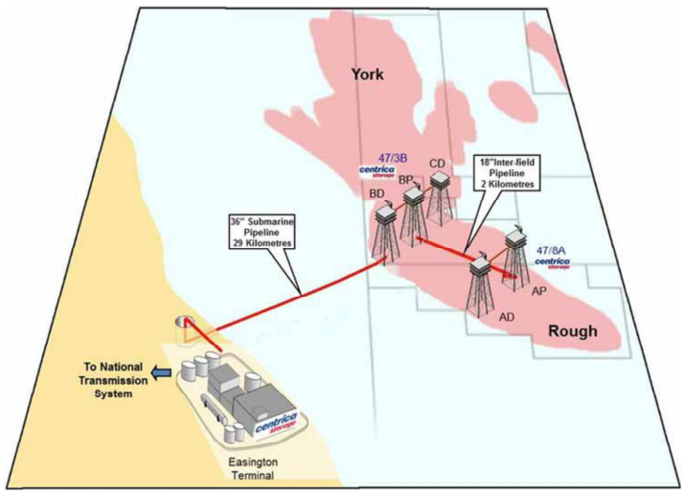
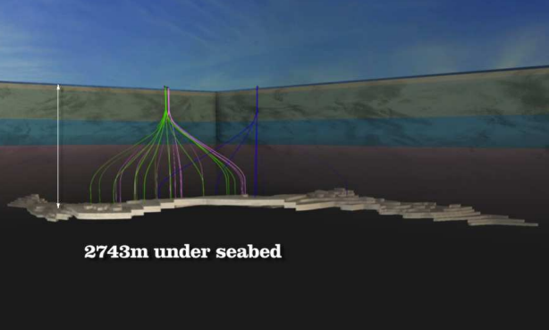
The Rough reservoir remains the only proven large scale gas storage facility in the UK with favourable technical characteristics
The Rough reservoir is located 29 km offshore from Easington, spanning an area of approximately 30 km² and is located approximately 2.7 km under the seabed
The facility currently consists of the Rough reservoir, two (manned) offshore installations (47/8A and the 47/3B) and the Easington Terminal
The two offshore installations are connected to Rough via 30 wells and connected to each other via a 2 km long 18” inter-field pipeline
It is the “Goldilocks” of the sector as it meets requirements on temperature, dryness, size and proximity to land – it is the only proven offshore gas storage reservoir in the UK
2743m under the seabed
approximately nine Shards deep

Slide 7
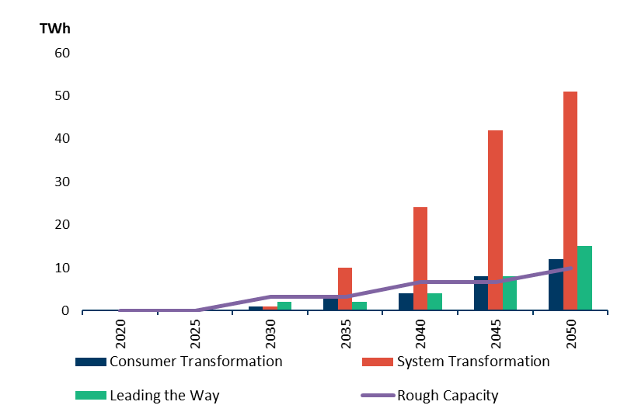
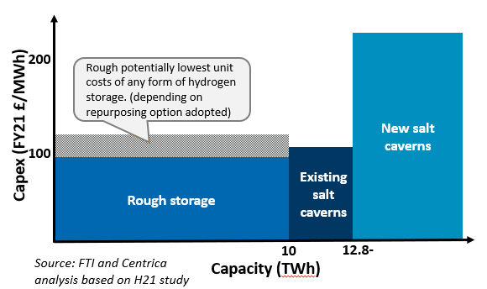
Rough is uniquely placed to deliver the UK’s accelerated hydrogen targets but requires the right regulatory support model
Significant volumes of H2 storage is required to reach Net Zero
Hydrogen storage will play a key role in providing “hyper-flexibility” in matching supply and demand so that minimal energy is wasted
The new 10GW hydrogen target by 2030 accelerates and amplifies the need for storage
In the long term, Rough can accommodate high storage requirements for which there is broad consensus; NG Future Energy Scenarios (FES) 2022 estimates 11-56 TWh by 2050; Committee on Climate Change (CCC) estimates 20 TWh by 2050
The UK currently has no established hydrogen storage capacity and existing operational salt caverns will be needed for interim methane use
Rough can provide up 10TWh of hydrogen storage to be brought online in phases of ~3TWh, reaching 10TWh when needed
These incremental increases in capacity can be adjusted to reflect the need for hydrogen storage
Rough can be the key to the UK’s long term needs for hydrogen storage
Storage is best suited to leading the hydrogen transition, providing support and structure to the nascent hydrogen economy
National Grid’s FES 2022:
‘Large-scale geological hydrogen must commence now to support an electricity system without unabated natural gas after 2035.’
‘The whole energy system of the future will require strategic storage to balance inter-seasonal demand and supply and increase resilience against external security of supply risks.’
Merit order of 100% H2 storage options, £/MWh of storage

Slide 8
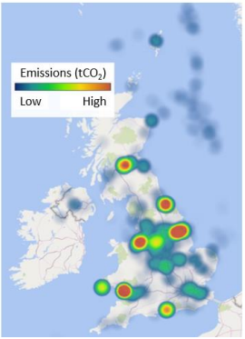
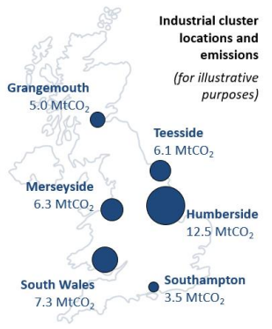
There are locational benefits from Rough’s proximity to the largest industrial cluster – the combined East Coast Cluster
Centrica is a partnership organisation to Zero Carbon Humber, which is aiming for the East Coast Cluster to be the world’s first net zero industrial region by 2040
Proximity to wind generation
Heat map of 2018 point source emissions (left) correlates directly to the corresponding locations of the UK’s six major industrial clusters²
Dogger bank A-C 3.6 GW of installed capacity by 2025 with sub-station located at Saltend.
Hornsea 1-4 will have 6 GW of installed capacity by 2027 with the sub-station located at Immingham.
In 2020, the UK curtailed its wind energy generation on 75% of days, amounting to over 3.6 TWh of curtailed generation (c.5%) which could have been stored and subsequently delivered back to the grid or supplied directly to consumers.¹
Proximity to major conurbations
Rough could support hydrogen fuelled homes and businesses in the North East under the scenario that conversion of heating will roll out from industrial clusters to local areas.
Rough’s vicinity to the Humber cluster places it strategically in an area where heating with hydrogen may become prevalent in the late 2020s, requiring much greater seasonal storage and capability for hydrogen to meet demand patterns.
Source: (1) BEIS Longer Duration Energy Storage guidance notes (2) Element Energy Deep-Decarbonisation Pathways for UK Industry, Emission values shown on the map for the industrial clusters are 2018 baseline emissions, including both point and non-point source emissions within a 50km radius of each cluster

Slide 9
Today, Rough is supporting the UK’s energy resilience and will help keep consumer prices lower
10 year storage licence granted to Centrica
30bcf potential storage capacity available this winter
Injecting gas since September
20bcf+ currently in field
Investment made solely by Centrica
No regulatory support model required for this winter
Full development re quires the right regulation to:
Secure £2bn of investment
Create thousands of jobs
Reduce prices for consumers
Deliver the UK’s hydrogen targets
Continued discussions with UK Government on developing the right regulatory framework to support the long term development
No government investment required
Rough essential to enable the UK’s hydrogen economy and return the UK to being a net exporter of energy

